Slide 1


Home
Tours Page
News
Contact
World Travel
E- TICKETING
Let your dreams be your wings ..............
LET’S GET STARTED
Page |
01.

Slide 2



Home
Tours Page
News
Contact
PRESENTED BY:
AP21110010383 – Vijaya Vaishnavi.A
AP21110010384 –Sriya Kommuri
AP21110010385 – P Subanaveen
AP21110010386– Naga Sudheera.G
Page |
02.

Slide 3
Home
Tours Page
News
Contact
CONTENTS
INTRODUCTION
SYSTEM REQUIREMENTS
TOOLS AND REQUIREMENTS
RESULTS
CONCLUSION
Page |
03

Slide 4
Home
Tours Page
News
Contact
INTRODUCTION:
In the flight ticket booking system, there are two primary actors: users/passengers and admins/staff. Upon accessing the website or app, users are greeted with a homepage offering various functionalities such as searching for flights, managing bookings, and accessing their account. Admins oversee flight and booking management, while users can conveniently register, search for flights, and make bookings, receiving confirmation codes for their reservations.
In the flight ticket booking system, users navigate a user-friendly interface to search for flights based on their preferences, select seats, provide passenger details, and make secure payments, receiving confirmation codes for their reservations. Admins oversee flight and booking management, ensuring accurate inventory, processing bookings, and providing customer support. They also handle system maintenance and updates, ensuring the platform operates smoothly. Together, users and admins facilitate seamless transactions and enhance the overall experience for travelers and airline providers alike.
Page |
04

Slide 5

Home
Tours Page
News
Contact
SYSTEM REQUIREMENTS:
Software requirements:
Operating System : Linux, Windows, MacOS
Accessing Data From DataBase : MongoDB
Client Side Technologies : ReactJS
Server Side Technologies : NodeJs
DataBase Support : MongoDB
Browser Support : Firefox, Chrome, IET and above
Hardware requirements:
Dual-core 64-bit processor
8 GB of memory
Up to 24 GB of internal storage (Kony Visualizer: 4GB, Android SDK: 2GB, Windows SDK: 4GB, BlackBerry NDK: 4GB, plus ample space for multiple complex projects)
Network interface card
Windows 10, Windows 8.1 Update, Windows 8, and Windows 7.
Page |
05

Slide 6
Home
Tours Page
News
Contact
FUNCTIONAL REQUIREMENTS:
NON FUNCTIONAL
REQUIREMENTS:
User Registration/Login:
Search Flights:
Flight Selection:
Seat Selection:
Booking:
Payment Processing:
Ticket Confirmation:
Cancellation/Modification:
Flight Status:
Performance:
Reliability:
Security:
Scalability:
Usability:
Compatibility:
Availability:
Error Handling:
Backup and Recovery:
Page |
06

Slide 7
Home
Tours Page
News
Contact
Tools and Requirements:
Visual studio code
React
express
nodeJs
MongoDb
Page |
07

Slide 8
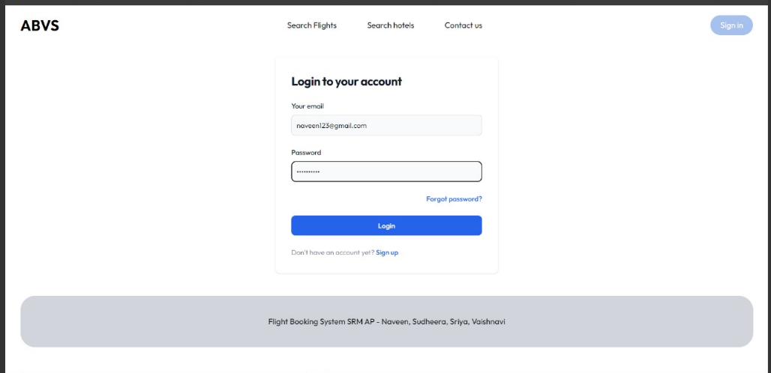
RESULTS
Home
Tours Page
News
Contact
Login Page:
Page |
08

Slide 9
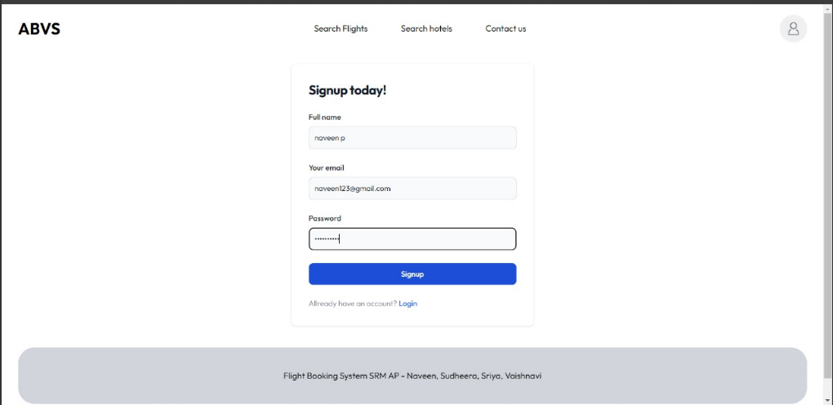
Home
Tours Page
News
Contact
Registration Page:
Page |
09

Slide 10
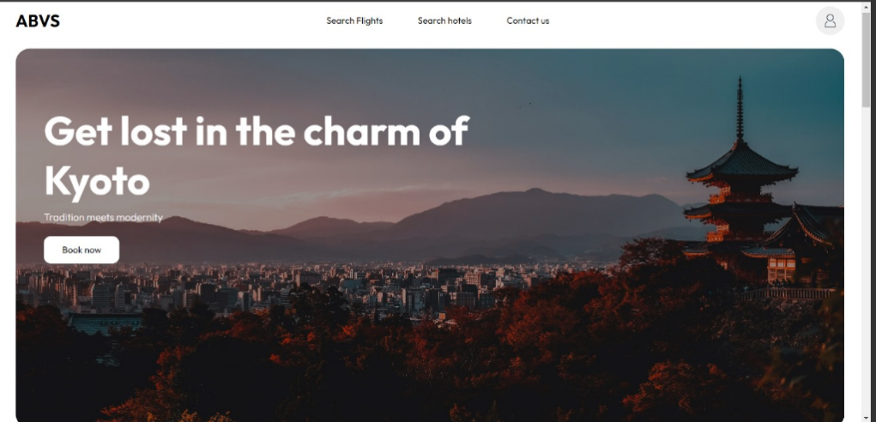
Home
Tours Page
News
Contact
Home Page:
Page |
10

Slide 11
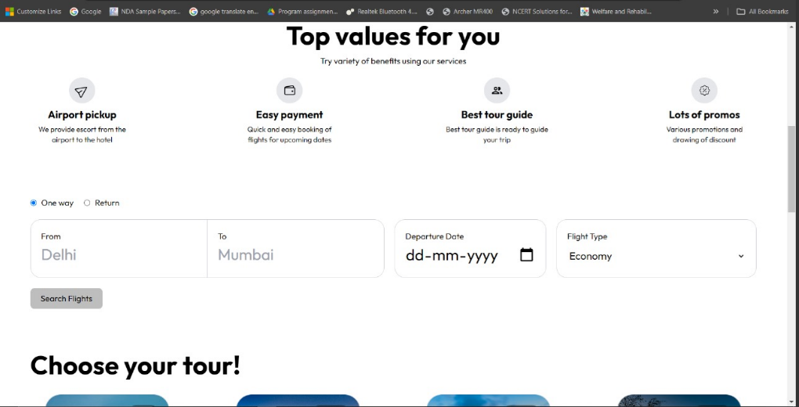
Home
Tours Page
News
Contact
Page |
11

Slide 12
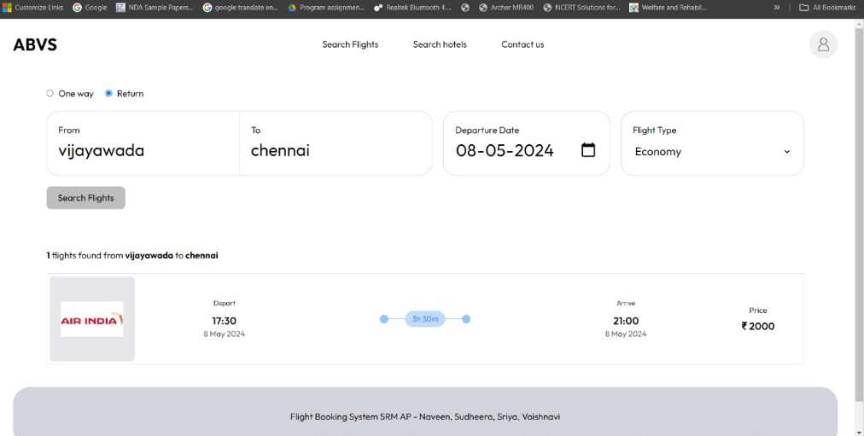
Home
Tours Page
News
Contact
flight Booking page:
Page |
12

Slide 13
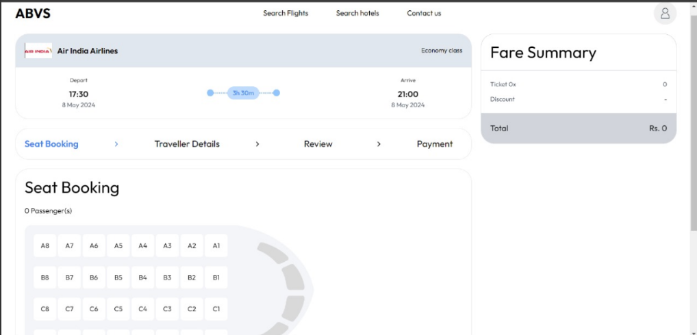
Home
Tours Page
News
Contact
seat allocation page:
Page |
13

Slide 14
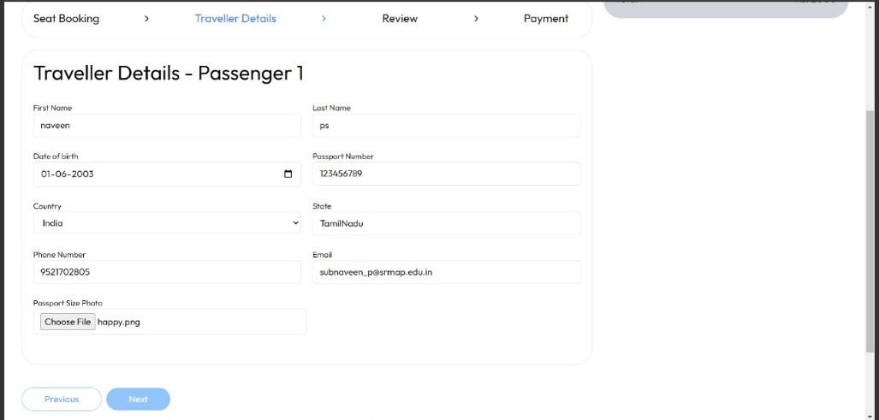
Home
Tours Page
News
Contact
Page |
14

Slide 15
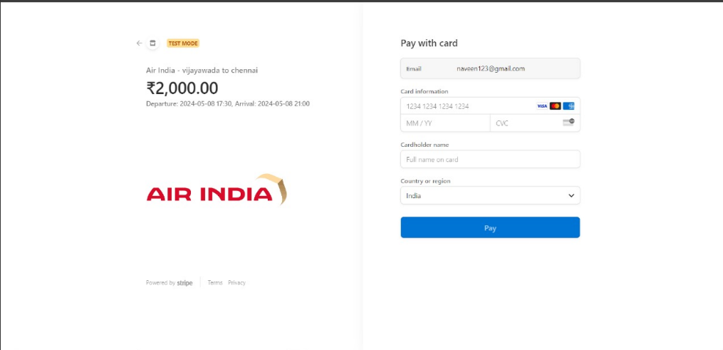
Home
Tours Page
News
Contact
Payment page:
Page |
15

Slide 16
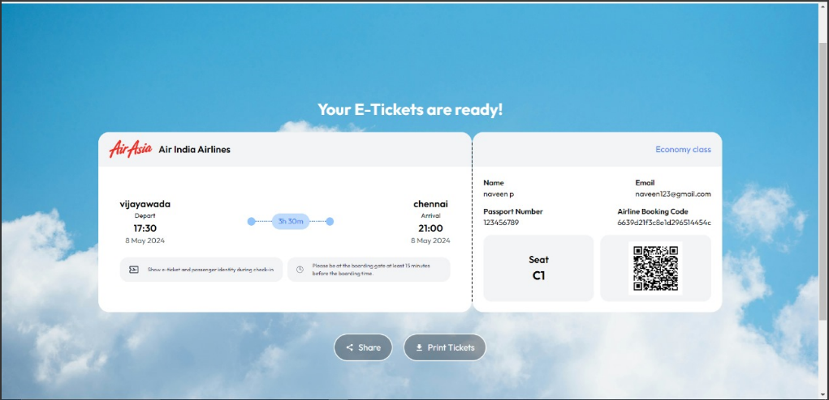
Home
Tours Page
News
Contact
Ticket generation page:
Page |
16

Slide 17
Home
Tours Page
News
Contact
CONCLUSION:
Flight ticket reservation systems have evolved significantly with technological advancements, enabling airlines to efficiently manage bookings and passenger interactions. While these systems are instrumental in ensuring smooth operations and enhancing the overall passenger experience, their initial installation costs can be substantial. To remain competitive in the dynamic airline industry, carriers must carefully select reservation systems that align with their specific requirements and deliver exceptional service to travelers. This entails investing in solutions that optimize booking processes, streamline operations, and prioritize passenger satisfaction, ultimately contributing to the airline's success in a fiercely competitive market.
Page |
17

Slide 18

Home
Tours Page
News
Contact
THANKS FOR
WATCHING.
Page |
18

